Slide 1
INTEGRATION OF BUILT-IN MODULES

Slide 2
MODULE TO BE COVERED
Image slider
http://www.menucool.com/javascript-image-slider
http://www.devtrix.net/sliderman/
http://amazingslider.com/
Tooltip
http://jsbin.com/owupil/10/edit
Dhtmlx
http://www.dhtmlx.com/docs/products/dhtmlxCalendar/

Slide 3
Dhtmlx
Step 1
../dhtmlxcanlendar/codebase/dhtmlxcalendar.css
../dhtmlxcanlendar/codebase/skins/dhtmlxcalendar_dhx_skyblue.css
../dhtmlxcanlendar/codebase/dhtmlxcalendar.js

Slide 4
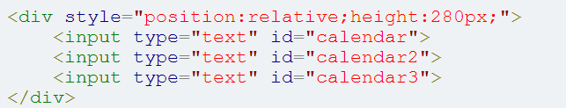
Dhtmlx
Step 2
Step 3
Note: you should call doOnLoad() any javascript event otherwise your calendar not show

Slide 5
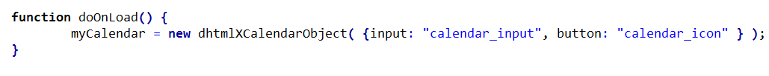
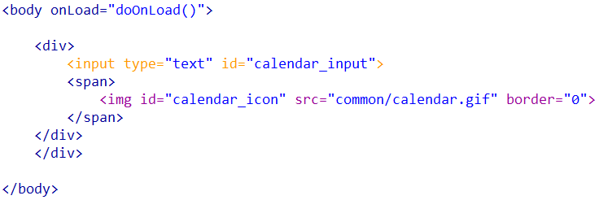
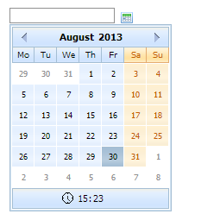
Dhtmlx
Icon

Slide 6
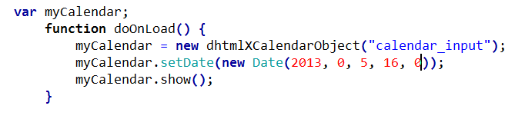

Dhtmlx
Custom Date

Slide 7
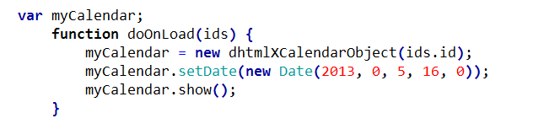
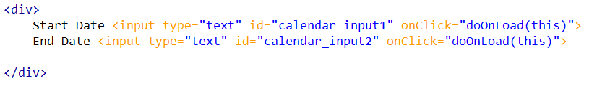
Dhtmlx
Multiple Input Fields

